Slide 1


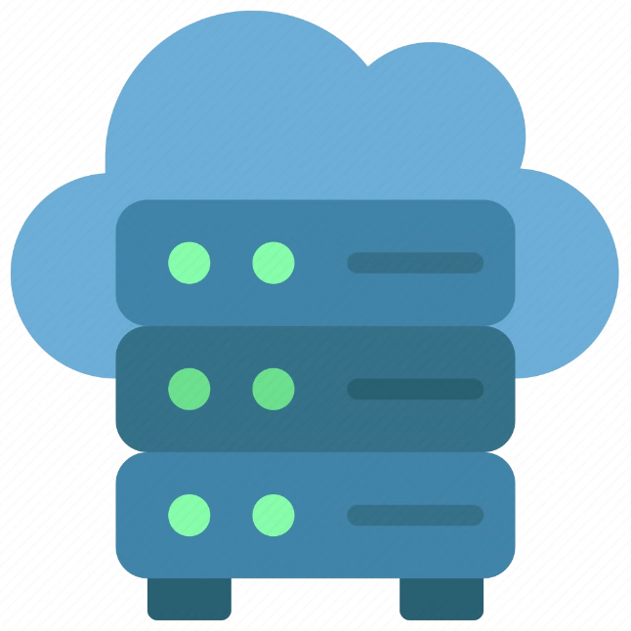
Introduction to Cloud and On-Premises Computing
This presentation will provide an overview of cloud and on-premises computing, outlining their key differences, advantages, and disadvantages.
ra

Slide 2
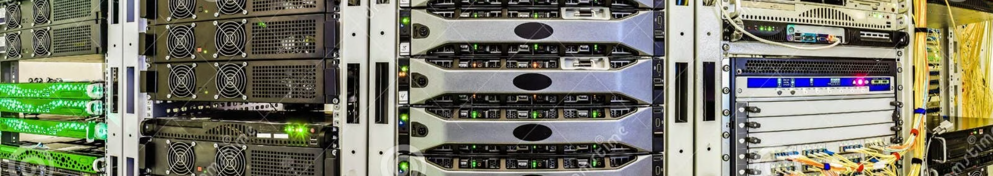
What is Cloud Computing?
Cloud computing refers to the delivery of computing services—including servers, storage, databases, networking, software, analytics, and intelligence—over the Internet ("the cloud").
Infrastructure as a Service (IaaS)
Platform as a Service (PaaS)
Software as a Service (SaaS)
Offers a platform for developing, running, and managing applications without worrying about infrastructure.
Delivers software applications over the internet, allowing users to access them from anywhere.
Provides access to computing resources like servers, storage, and networking.

Slide 3

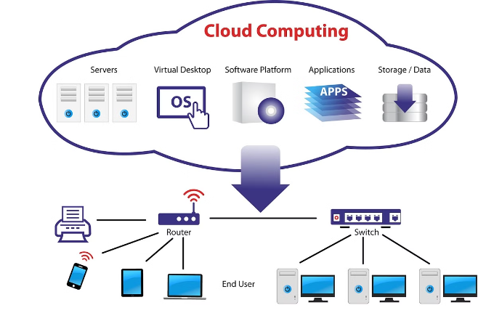
Advantages of Cloud Computing
Cloud computing offers numerous advantages for businesses and individuals, enabling flexibility, scalability, and cost savings.
1
Cost-effectiveness
2
Scalability
Pay-as-you-go pricing model eliminates upfront investments and reduces operational costs.
Easily adjust resources based on demand, allowing businesses to scale up or down as needed.
3
Accessibility
4
Security
Access data and applications from anywhere with an internet connection, promoting remote work and collaboration.
Cloud providers invest heavily in security, offering advanced protection against threats and data breaches.

Slide 4

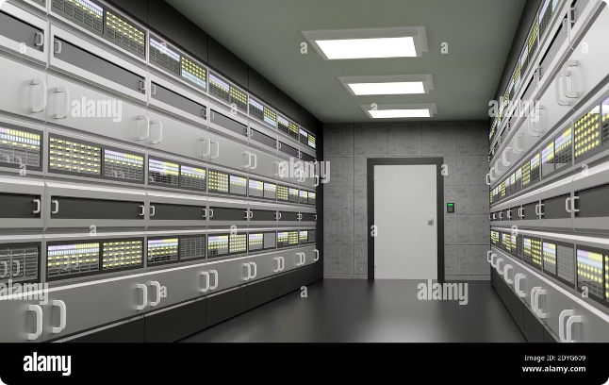
What is On-Premises Computing?
On-premises computing refers to hosting and managing IT infrastructure within an organization's own physical data center.
Hardware
Servers, storage devices, networking equipment
Software
Operating systems, applications, databases
Security
Firewalls, intrusion detection systems, physical security

Slide 5
Advantages of On-Premises Computing
On-premises computing offers control, security, and customization, making it a suitable option for specific needs.
Control
Security
Customization
Complete control over hardware, software, and data, allowing for tailored configurations.
Enhanced security measures, including physical access control, can be implemented to protect sensitive data.
Customize infrastructure to meet specific requirements, providing flexibility for unique workloads.

Slide 6

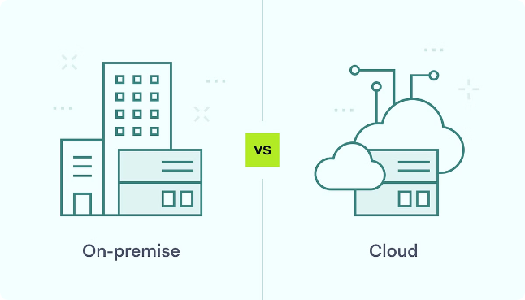
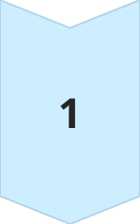
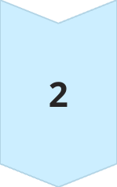
Comparison of Cloud and On-Premises Computing
The choice between cloud and on-premises computing depends on various factors, including budget, security needs, and application requirements.
Cloud Computing
Scalable, cost-effective, accessible, and secure.
On-Premises Computing
Provides control, customization, and enhanced security for sensitive data.

Slide 7

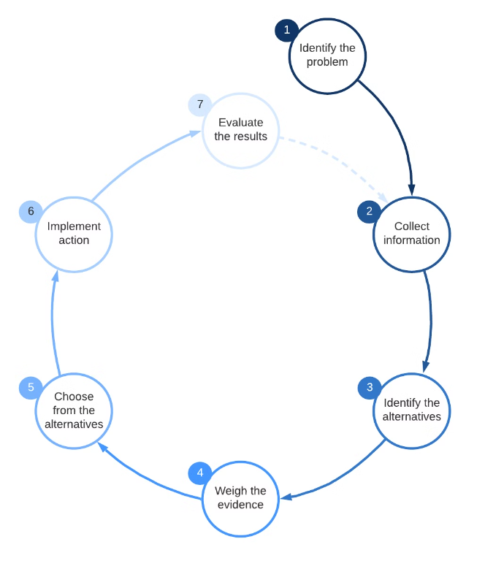




Factors to Consider When Choosing Between Cloud and On-Premises
Consider factors like budget, security, compliance, scalability, and application requirements when making the decision.
Cost
Security
Analyze the cost of infrastructure, maintenance, and staffing for both cloud and on-premises solutions.
Assess security risks and compliance requirements to ensure data protection and regulatory compliance.
Scalability
Application Requirements
Consider future growth and the ability to easily scale resources based on evolving needs.
Evaluate application compatibility, performance, and integration with existing systems for both cloud and on-premises.

Slide 8

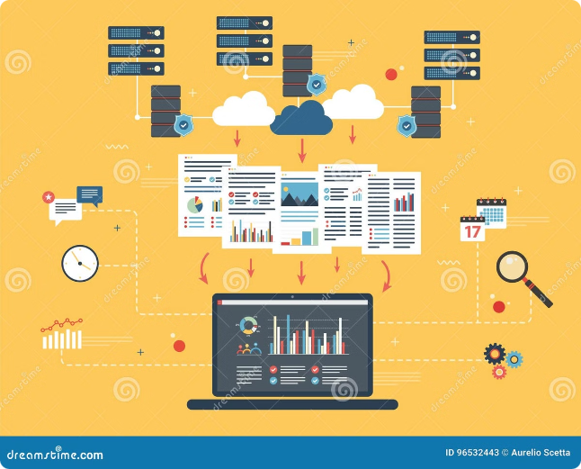
Conclusion and Recommendations
Cloud computing offers a flexible, cost-effective, and scalable solution for many businesses.
However, on-premises computing remains a viable option for organizations with specific control, customization, and security requirements.
Ultimately, the best choice depends on individual business needs and priorities.

